Slide 1
UniPrint Portal
Get Price | Obtain Quote / Submit Order

Slide 2
Workflow
PRINTER INVOICES (via Finance One APES Workflow)
CUSTOMER LOGON TO PORTAL
CUSTOMER SELECTS ITEMS REQUIRED
PRINTER DELIVERS GOODS
UNIPRINT PROCESSES ORDER

Slide 3
Recommended browsers
Copy the following link & save to your favorites
https://unisa.printiq.com/login.aspx
*Secure site: Ensure full link is used https://

Slide 4
Login using your UniSA Login
Username
Password
Click Sign In

Slide 5
Step 1 Select Product

Slide 6
Step 1.1
Click Get Price

Slide 7
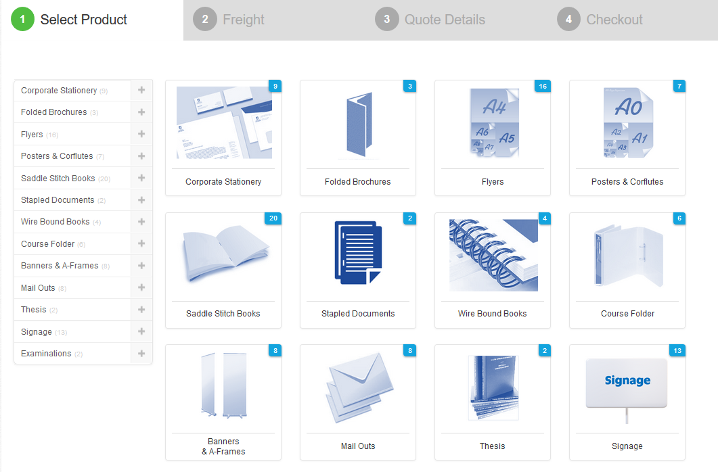
Step 1.2
Click the required Product
Example: Ordering a Business Card
Click Corporate Stationery

Slide 8
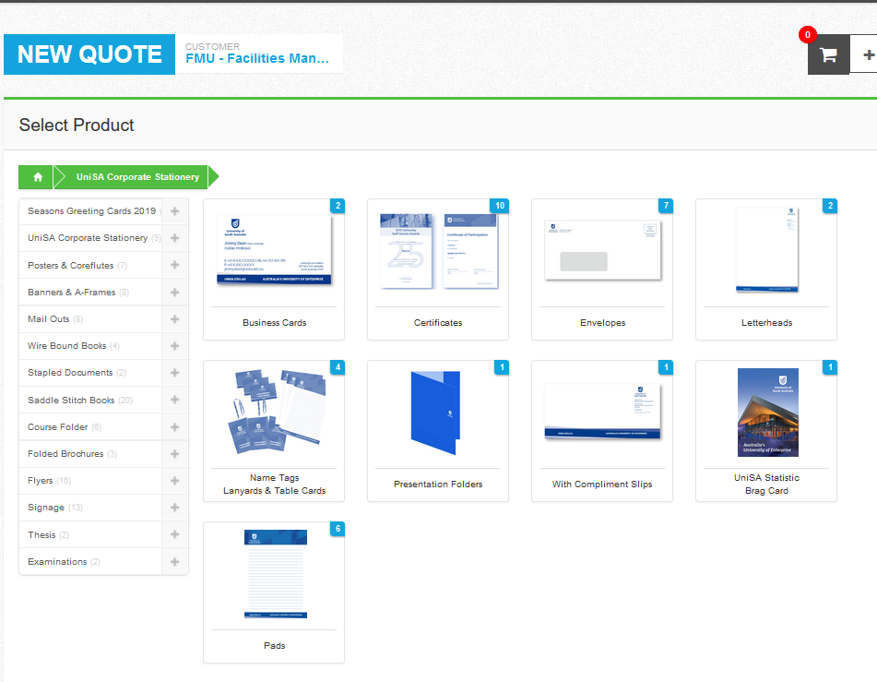
Step 1.3
Click
Business Cards

Slide 9
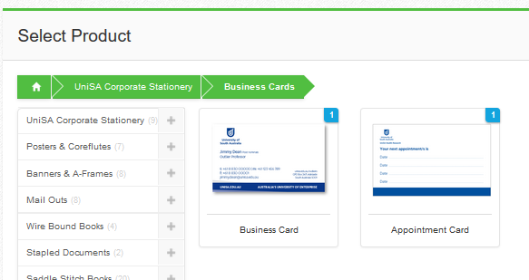
Step 1.4
Select card required

Slide 10
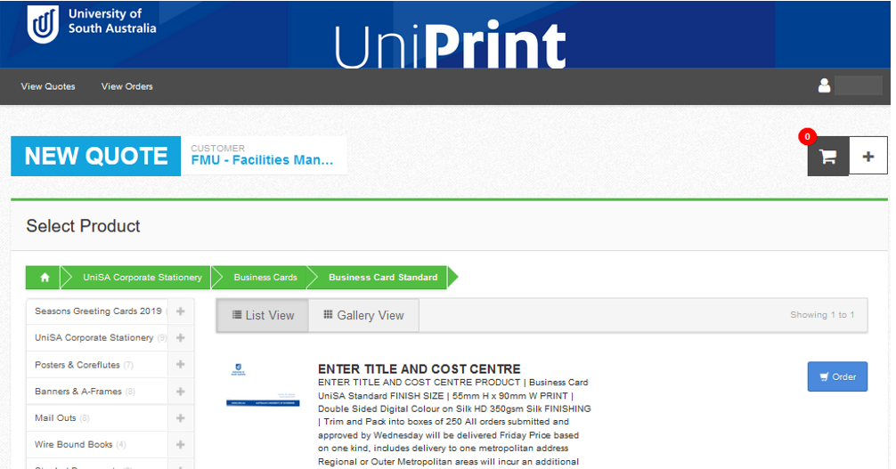
Step 1.5 Click Order

Slide 11
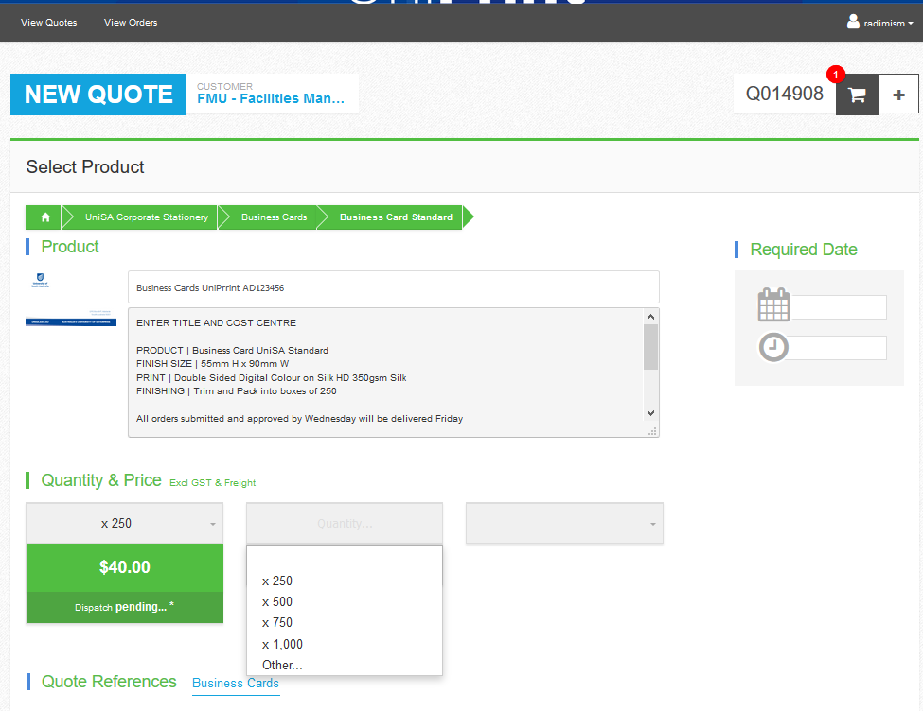
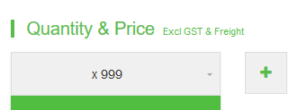
Step 1.6
Enter the Title and Cost Centre in the Job Title
Step 1.7
NOTE: Business Cards are delivered Friday if orders are submitted by Wednesday, if your order is urgent, used the Required date fields
Step 1.8
Select the quantity required
NOTE: Some items are available in set quantities
(E.g Business Cards: 250, 500 / 750 / 1,000)
If you require a price for more than one quantity, click + and use the drop-box as shown
Some product do not have set quantities. These products list qty as x 999 as example below
Select other and enter the quantity required

Slide 12
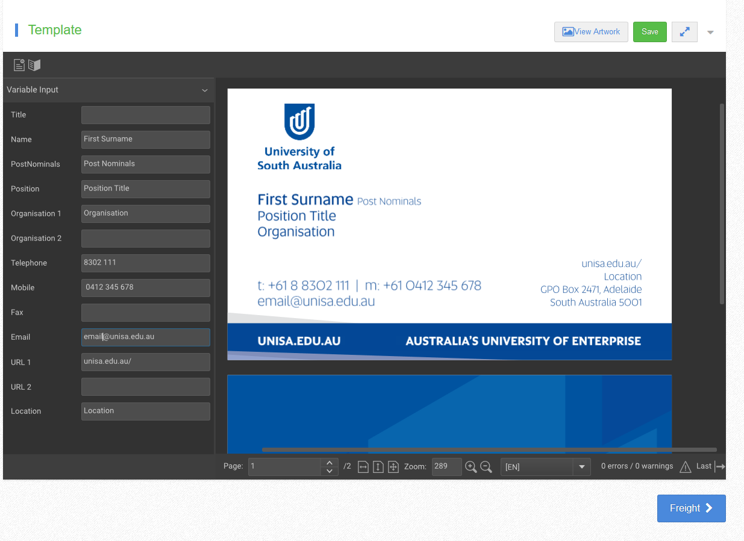
Step 1.9 Create Artwork
Enter your First & Surname
Enter Postnominals (if applicable)
Enter Position Title
Enter Organisation
Enter Telephone
Enter Mobile (add spaces required)
Enter Email
Enter URL (if applicable)
Enter Location (if applicable)
Click Save
Click Freight

Slide 13
Step 2 Enter Freight

Slide 14
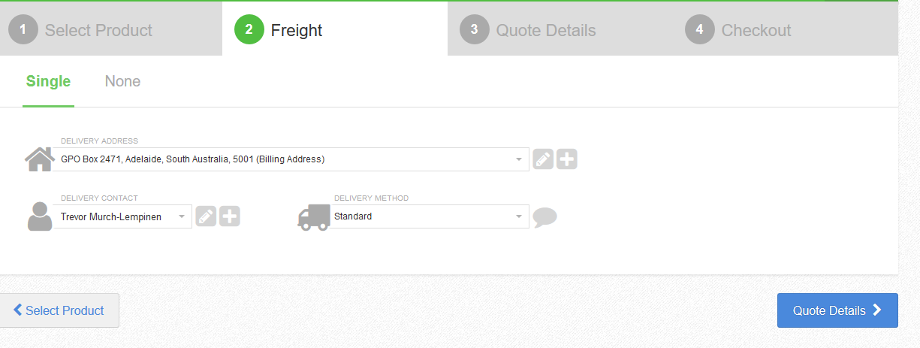
Enter your Delivery Address
Click on the + and enter your details (First time using Portal)
Enter the Delivery Contact
Click on the + and enter your details (First time using Portal)
Click Quote Details

Slide 15
Step 3 Quote Details

Slide 16
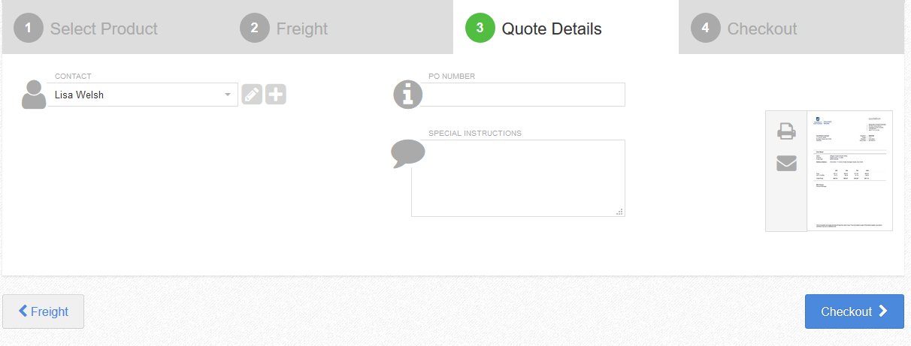
Enter your Contact
Click on the + and enter your details (First time using Portal)
Enter Special Instructions (if required)
If your details are not in the portal, click on the + and enter your details
Click Quote letter (to download for approval)
Click Checkout

Slide 17
Step 4 Checkout

Slide 18
If you have added more than one item, you can cancel a product by clicking on X
Click Complete Order

Slide 19
Contact UniPrint
Lisa Welsh | UniPrint Coordinator
T: 8302 1350
E: lisa.welsh@unisa.edu.au

