Slide 1
UniPrint Portal
Start Order | Generic Corporate Stationery

Slide 2
Workflow
PRINTER INVOICES (via Finance One APES Workflow)
CUSTOMER LOGON TO PORTAL
CUSTOMER SELECTS ITEMS REQUIRED
PRINTER DELIVERS GOODS
UNIPRINT PROCESSES ORDER

Slide 3
Recommended browsers
Copy the following link & save to your favorites
https://unisa.printiq.com/login.aspx
*Secure site: Ensure full link is used https://

Slide 4
Login using your UniSA Login
Username
Password
Click Sign In

Slide 5
Step 1 Start Order

Slide 6
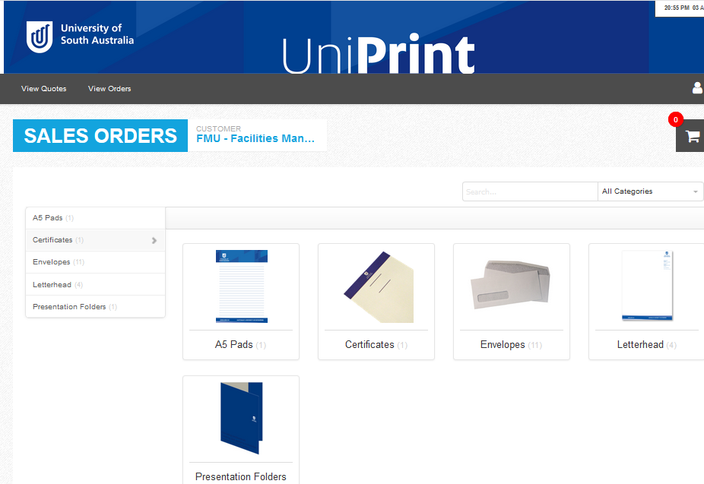
Step 2
Select Product

Slide 7
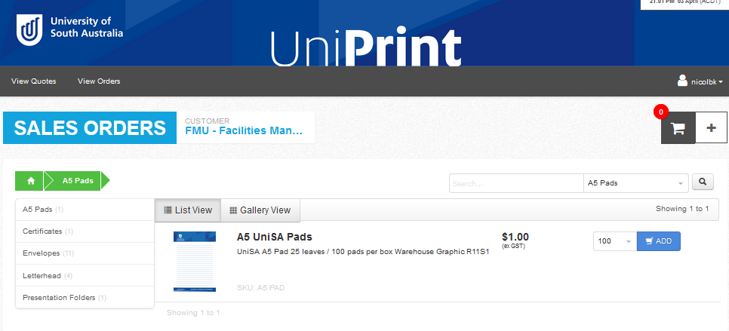
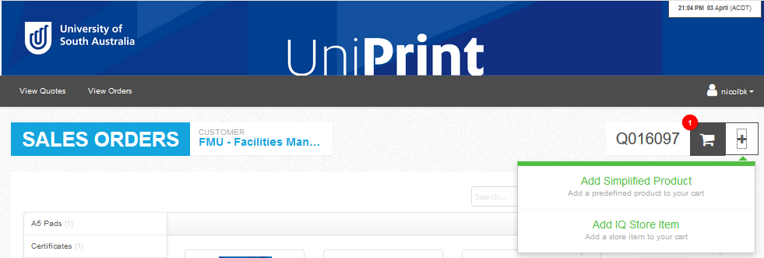
Step 3
Click Add
Each product is set in quantities per box, no split orders accepted
To add more products to the order, click +
Click Add IQ Store Item, repeat ordering process
Price is pick & pack cost
*GST exclusive
*Freight cost added upon checkout

Slide 8
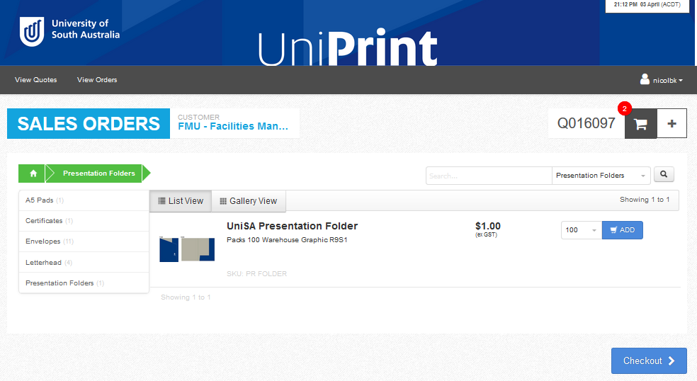
Step 4
Click Checkout

Slide 9
Step 5 Delivery
Enter your Delivery Address by clicking on the + enter your details
Enter the Delivery Contact by clicking on the + enter your details

Slide 10
Step 6 Invoice Details
Enter the Cost Centre in the NOTES section
Click Submit Order

Slide 11
Contact UniPrint
Lisa Welsh | UniPrint Coordinator
T: 8302 1350
E: lisa.welsh@unisa.edu.au

