Slide 1
PALS: Pregnancy & Lifestyle Study
Dr Judy Ford (now UniSA) & Team (at QEH)

Slide 2
The PALS Study & Teams
NH & MRC grant
Dr Judy Ford
Professor Tony McMichael
Project Leaders
Dr Judy Ford
Dr Janet Hiller
Team Members
PALS team: Leigh, Geoff & Jenny
Dr Leslie MacCormac
Associate Investigator – Dr B Pridmore
Biochemistry Lab

Slide 3
PALS – and without whom ………
Generous couples
Maxine Golding
Diane Beer

Slide 4
My reasons for publishing my data
PALS was a unique study because it was completely population based and did not use any clinical fertility interventions.
Couples were recruited and interviewed before they starting trying to conceive. Their progress was monitored every month.
The data record information and outcome for a defined period in time.
We only analysed some of the factors. For example, specific chemical exposures were noted but not analysed because of relatively low frequencies of individual exposures.
The data needs to be stored in a safe place.

Slide 5
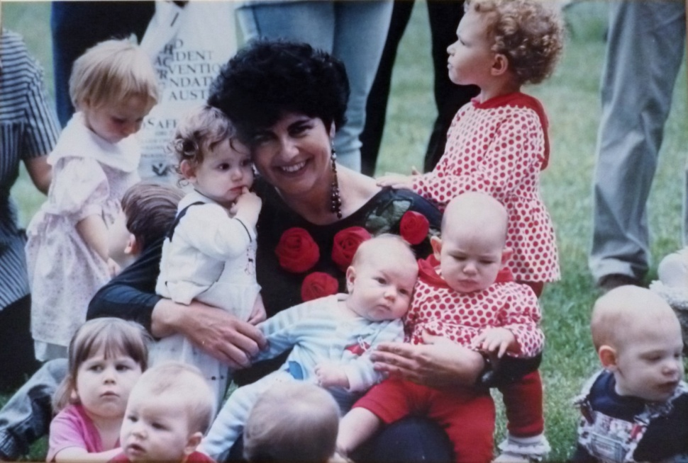
PALS Data
582 couples with adequate data
355 variables for each couple
Each couple has a single ID
Males questions and results have a suffix m and females a suffix f
Potentially identifiable data – dates and postcodes have been removed.

Slide 6
PALS Data
File 1: pdf that lists the codes and description of each of the 355 variables.
File 2: xls file of the coded data
File 3: Contains ASCO – Australian Standard Classification of Occupations used in the study

Slide 7
PALS Data
The database also includes:
A description of the data – about 120 words
Keywords – as many as are relevant to allow different types of researchers to find the data
A list of the publications that have been written from the data.

Slide 8
Examples of Variable descriptions in PALS Database Metadata
In many cases the Variable name for males and females is the same. Whether the answer is given by the male or the female is indicated by m (male) or f (female) at the end of the Variable name
A. CoupleID = ID of Couple - this was established at the female registration and so has an ‘f’ at the end e.g. P0001f
B. Dateintm = Date of Male interview
C. Maleage = male age at interview
D. Questcm = mode of completion of questionnaire:
1=face to face, 2=telephone, 3=mail
E. Cobm = country of birth male:
1. Australia
2. United Kingdom
3. Other English speaking country
4. Italy
5. Central Europe
6. Greece
7. Asia
8. Other

Slide 9
Variables in PALS Excel Database Metadata
F. YrMigrm = Year of migration (actual year given as two digits - 19xx)
G. Educasm (School Education)
Form 6/Year 12 (full schooling)
Form 4/Year 10
Less than year 10
H. Educatm (post school education)
1. Trade Training
2. Formal tertiary training
I. Occup1m – occupations were coded according to the Australian Bureau of Statistics (ABS) Occupational classifications. The full codes are in the separate file Appendix 2. If a single figure is used, this indicates a general role in a particular group e.g ‘4’ = general tradesperson.

Slide 10
Accessing PALS open data
To access the PALS data, go to the ANDS website and search on PALS or JUDITH FORD
http://ands.org.au/
Ethics approval to publish data was received from the Human Ethics Committees of both QEH and UniSA.

Slide 11
Publishing an Open Data Paper
Publish a paper about your data that links to your dataset in ANDS
There are now open-data journals e.g. Open Health Data
Make it a condition of data usage that your paper is cited.

Slide 12
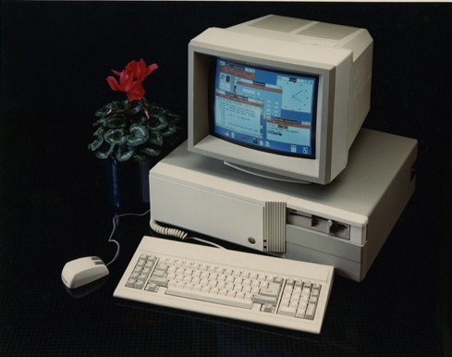
The history of the PALS data
Initial personal data stored in dBase
dBase (also stylized dBASE) was one of the first database management systems for microcomputers, and the most successful in its day. The dBase system includes the core database engine, a query system, a forms engine, and a programming language that ties all of these components together.

Slide 13
The history of the PALS data
1. Interviews recorded on paper
2. Data entered into first version of SPSS in Windows. Male and female files were separate.
3. Files saved on individual ‘floppy’ discs.
4. In 2006, SPSS converted files so they could be read by current version of the program and have been regularly updated.
5. In 2010, male and female files successfully merged.

Slide 14
New research inspired by PALS
New analysis and publication in 2011, showed highly significant association between having had a positive Pap smear and having a baby with IUGR.
Now awaiting data from a data linkage (per SANT Datalink) between the perinatal statistics and the Pap smear databases.

Slide 15
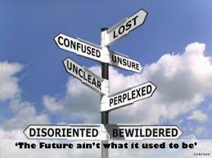
Where might your data be used?

