Slide 1

Instructions how to order
2024 Seasons Greeting Cards
via UniPrint Portal

Slide 2
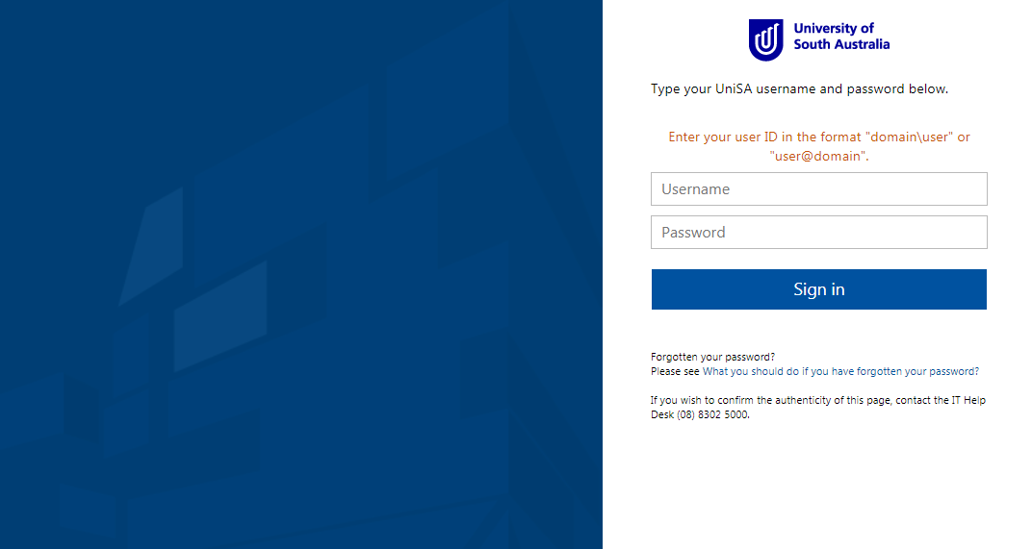
Copy https://unisa.printiq.com/login.aspx
Login using your UniSA Login
Enter your
UniSA Username
Password
&
Click Sign In

Slide 3
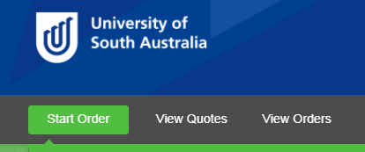
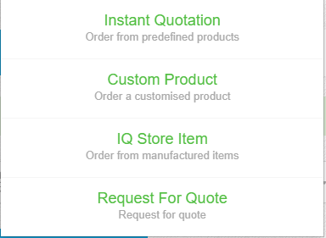
Select Start Order
Select Instant Quotation

Slide 4
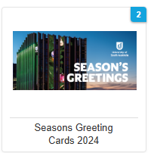
=
Select Seasons Greeting Cards 2024 Icon

Slide 5
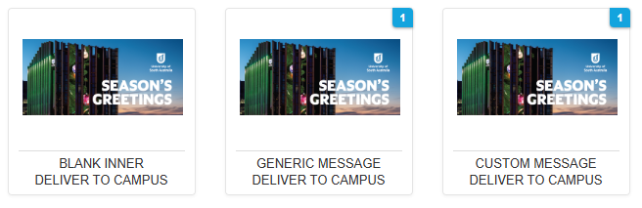
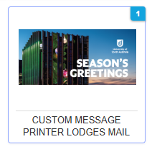
Select the icon for the option you require;
Deliver back to campus or Printer Lodge for Posting
Then select the option required

Slide 6
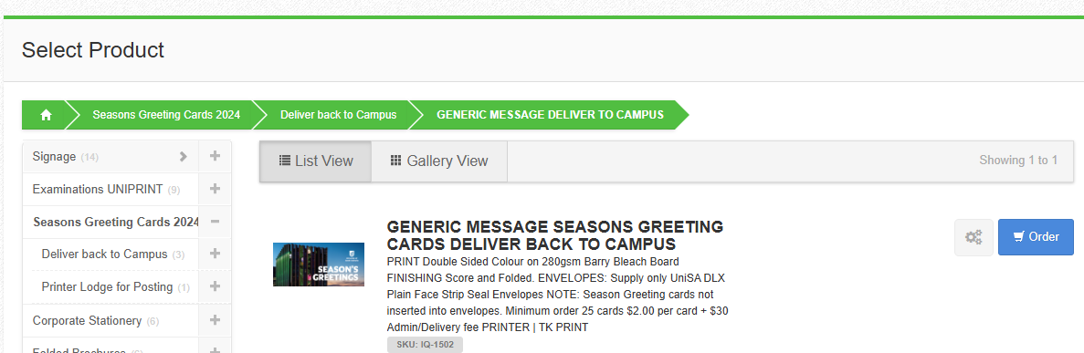
Click Order

Slide 7
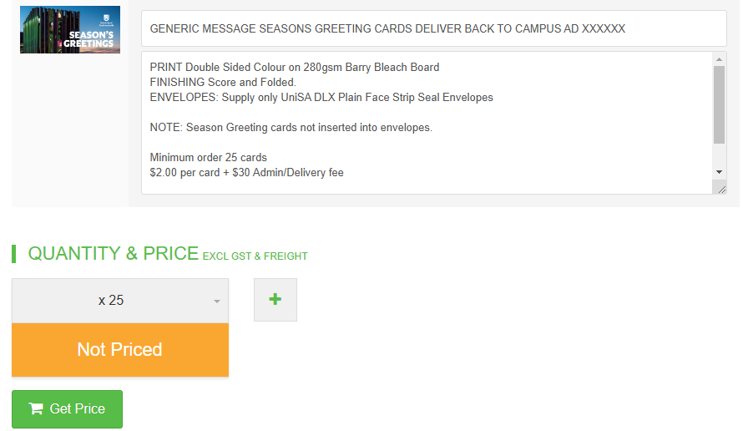
Enter the card option & cost centre in the Job Title
Select the Quantity required Select Get Price

Slide 8
CUSTOMISED CARDS ONLY
Email your text to uniprint@unisa.edu.au

Slide 9
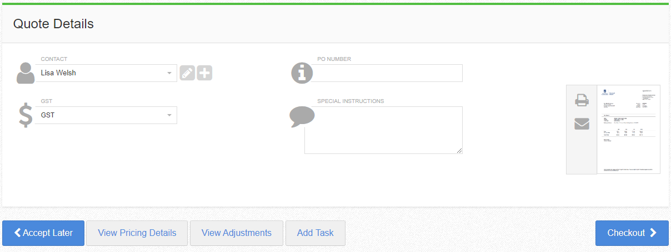
Enter your name in the Contact
Click Checkout

Slide 10
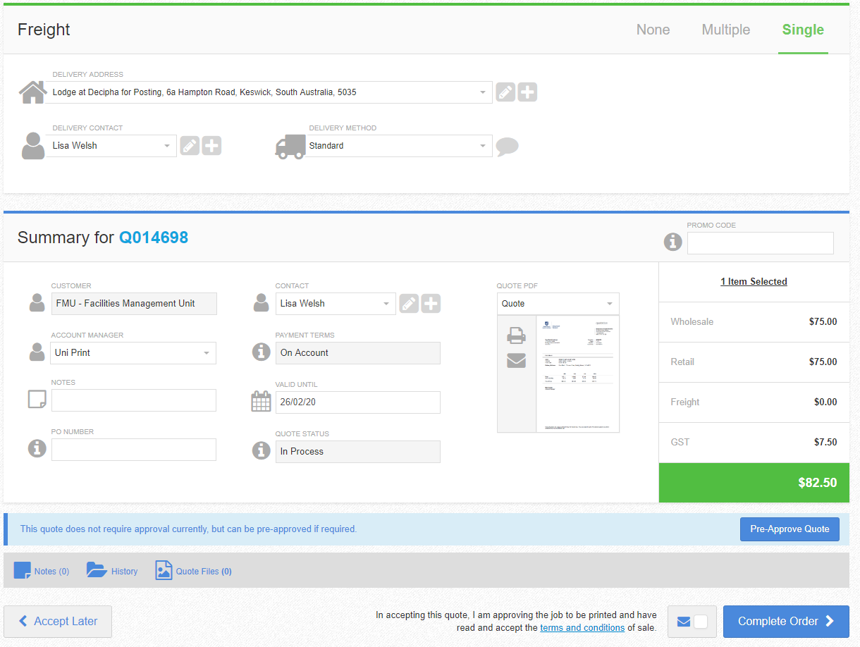
Enter your Delivery Address
Enter your name in Delivery Contact
Select Lodge at Australia Post
Click Complete Order

Slide 11
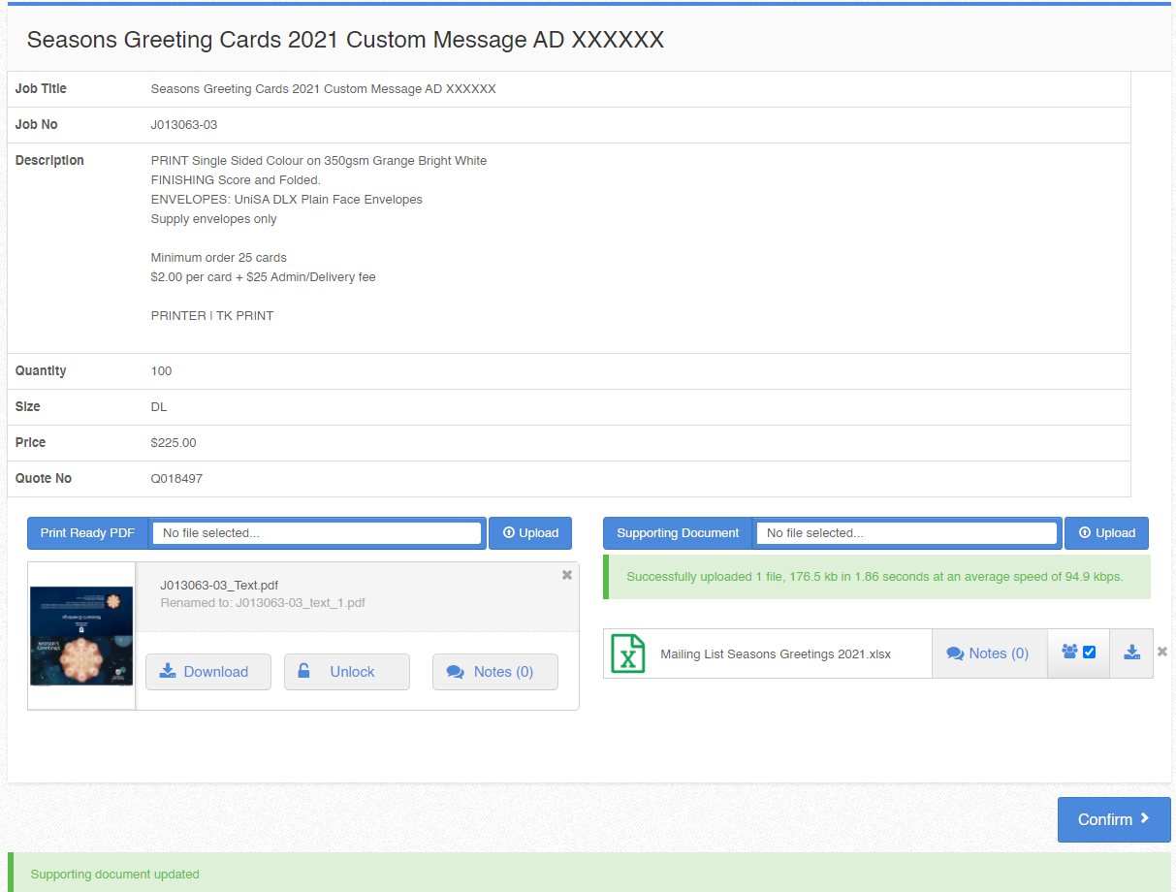
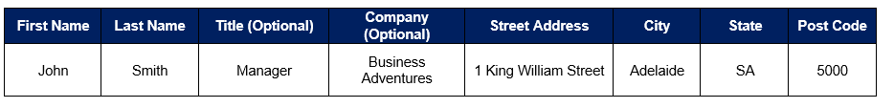
DIRECT POST ONLY
The Artwork is attached to your order
The Mail Addresses MUST be in Excel Format with all fields completed
Example how to set up your data
To upload the Address Data:
Click on the Supporting Document
Click on Upload
When the file appears check the Tick box
Click Confirm

Slide 12
Your order is now submitted to UniPrint
For further assistance
Amanda Kelly | Customer Support
T: 8302 1171
E: uniprint@unisa.edu.au
Lisa Welsh | UniPrint Coordinator
T: 8302 1350
E: uniprint@unisa.edu.au

